Slide 1


Systematic Investigation of Key Regulatory Elements for Lysine β-hydroxybutyrylation
HUANG He
Shanghai Institute of Materia Medica
2021-8-25

Slide 2

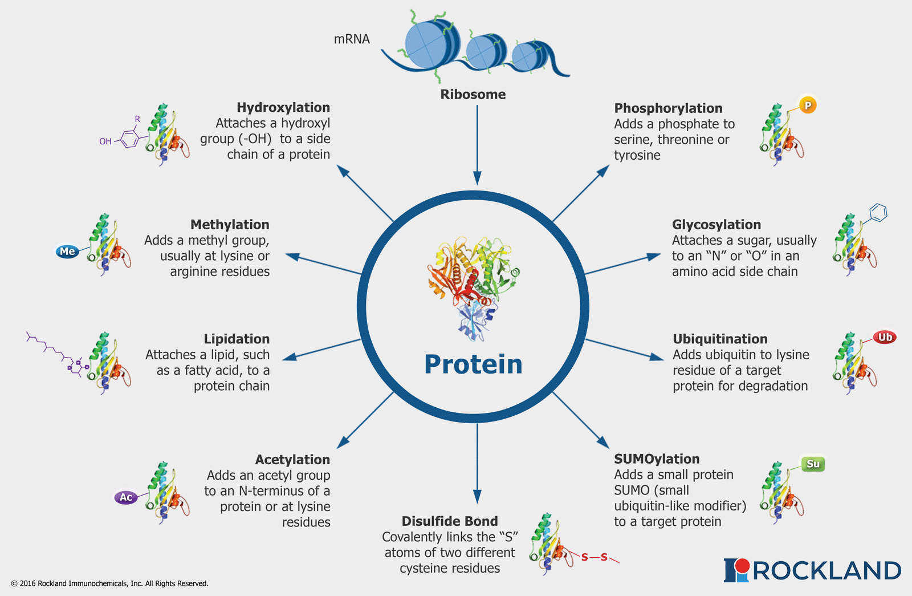
Posttranslational Modifications (PTMs)
https://rockland-inc.com

Slide 3
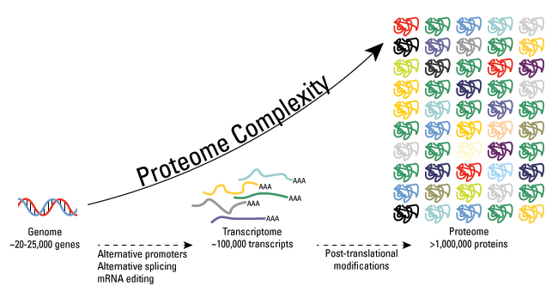
PTMs expands proteome complexity
www.thermofisher.com

Slide 4
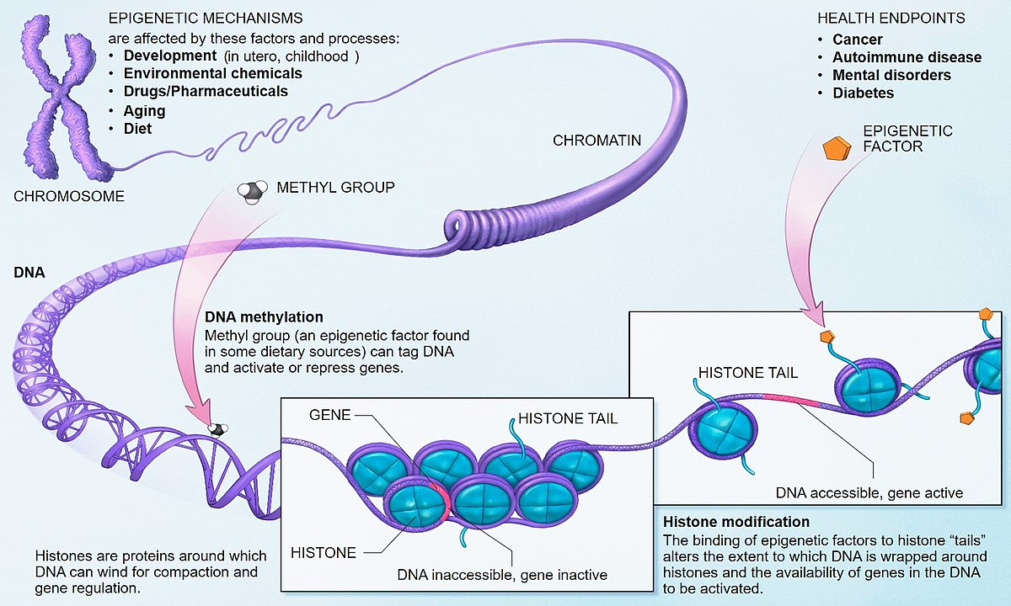

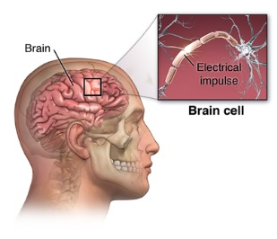
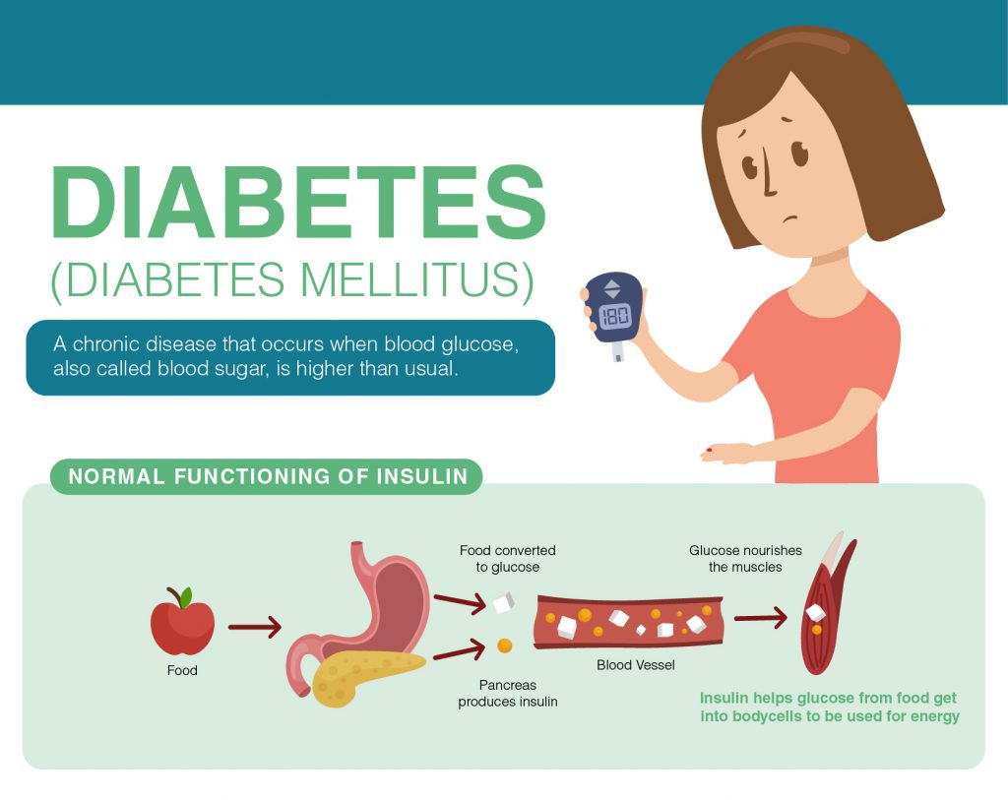
Aberrant PTM patterns are linked to diseases
Cancer
Neurodegenerative diseases
Diabetes

Slide 5
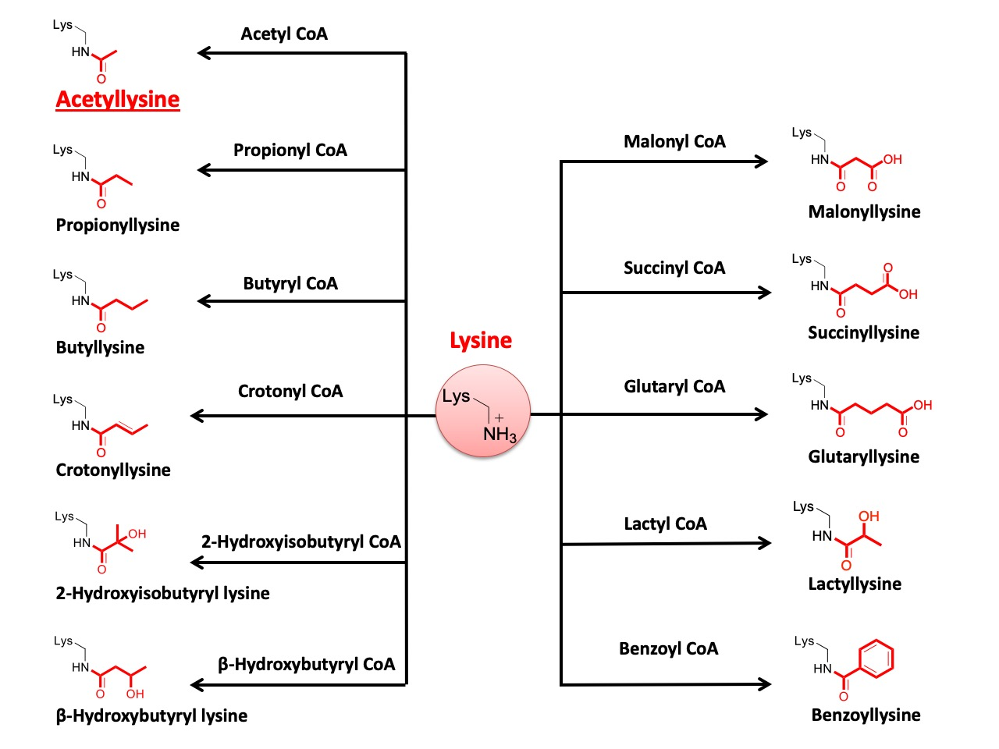
Novel PTMs
Huang H, Lin S, Garcia BA, and Zhao Y, Chem Rev, 2015, 115, 2376.
Huang H et al, and Zhao Y, Nat Commun, 2018, 9, 3374.
Zhang D, Tang Z, Huang H et al, and Becker L, Zhao Y, Nature, 2019, 574, 575.

Slide 6
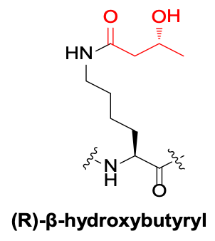
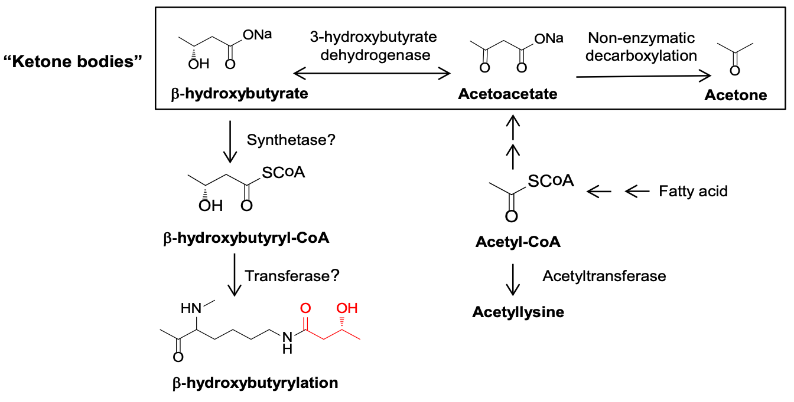
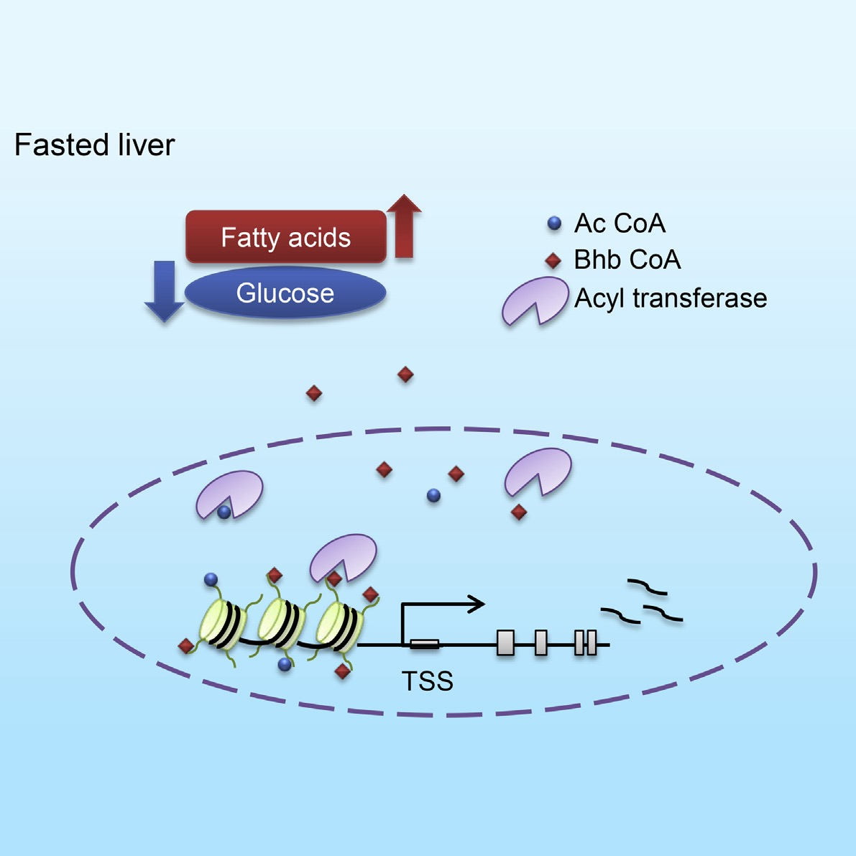
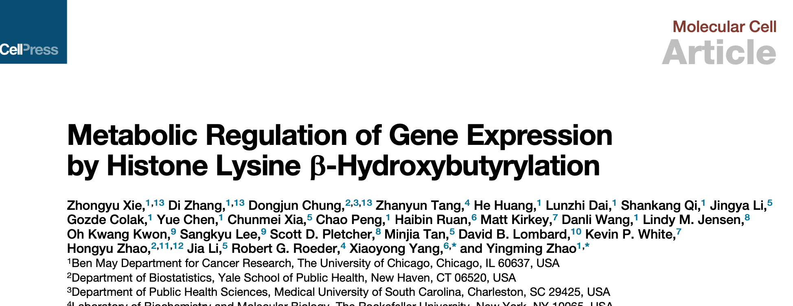
Lysine β-hydroxybutyrylation (Kbhb)
Mol Cell, 2016, 62, 194

Slide 7
Key questions for new PTMs
O
Readers
O
O
CoA
R
NH
R
Readers
NH
R
+
NH₂
Erasers
Substrates
Key question 1：Which enzymes can add or remove this PTM？
Key question 2：Which proteins are the substrates of this PTM？
Key question 3：Which proteins can be recruited by this PTM？

Slide 8
Key questions for Kbhb
ac-CoA
+
Acetyltransferase
bhb-CoA
+
Transferase?
Substrate?
HDAC
De-acylase?
Acetyl-lysine
Lysine
β-Hydorxybutyryl-lysine

Slide 9
p300 catalyzes Kbhb in vitro
RNA

Slide 10

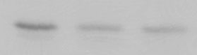


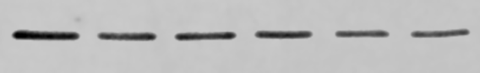
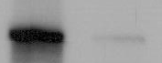
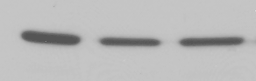
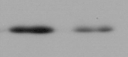
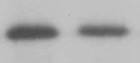


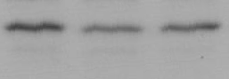
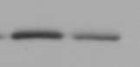
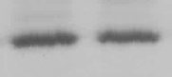

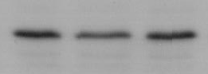
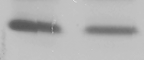
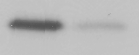

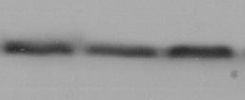

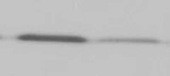
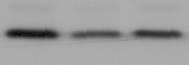



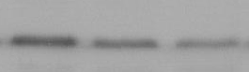
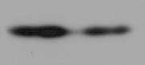
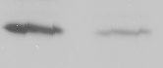

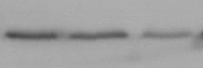
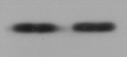
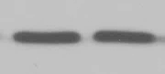

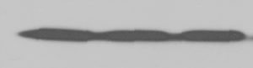
p300 catalyzes Kbhb in cells
HCT116
HCT116
MEF
A485
si-P300
p300-KO
siRNA
si-CBP
p300-KO
0 nM
40 nM
200 nM
1 µM
5 µM
10 µM
NS
NS
WT
WT
p300
H3K18ac
p300
p300
H3K9bhb
CBP
H3K18bhb
H3K9bhb
H3K9bhb
H3K9ac
actin
H3K9ac
H3K9ac
H3K9ac
H3K18bhb
H3K9bhb
H3K18bhb
H3K18bhb
H3K18ac
H4K8ac
H3K18ac
H3K18ac
H4K8bhb
H4K8bhb
H4K8bhb
H4K8bhb
H3K27ac
H4K8ac
H4K8ac
H4K8ac
H3K27bhb
Histone H3
Histone H3
H3
H3

Slide 11
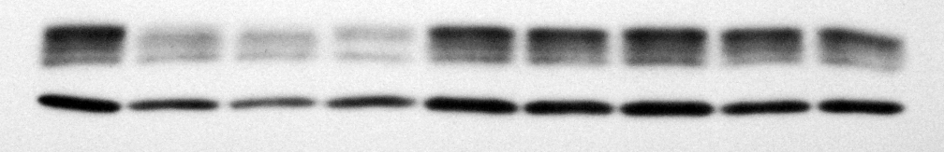
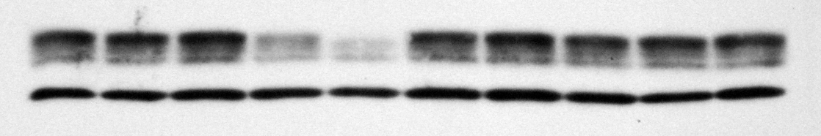
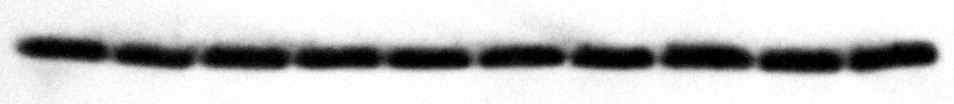
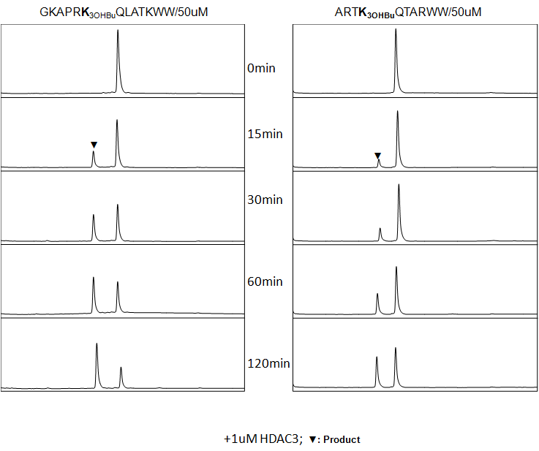
HDACs remove Kbhb in vitro
HDAC10
Control
HDAC4
HDAC9
HDAC11
HDAC5
HDAC2
HDAC6
HDAC1
HDAC3
HDAC7
HDAC8
SIRT4
SIRT7
SIRT3
SIRT6
SIRT2
SIRT5
SIRT1
H3
Pan-Kbhb
H2A/2B
H4
H3
+1 μM HDAC1
+1 μM HDAC2
+1 μM HDAC3
+1 μM SIRT1
+2.5 μM SIRT2
0 min
15 min
60 min
Peptide:
GKAPRK(bhb)QLATKWW
▼: de-Kbhb peptide
▼
▼
▼
▼
▼

Slide 12






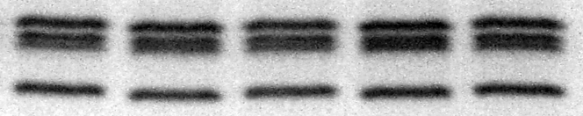

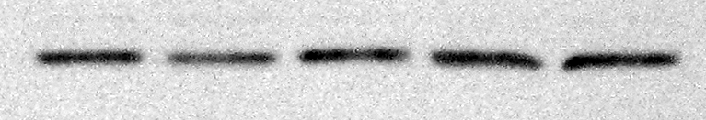
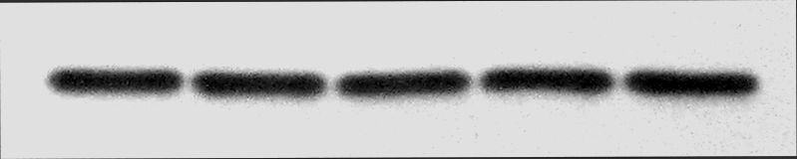
HDACs remove Kbhb in cells
HEK293
TSA
Control
2.0 μM
HEK293
0.4 μM
80 nM
16 nM
10 mM NaBu
20 mM NAM
H3K9bhb
0.5 μM TSA
DMSO
3 nM FK228
H3K4bhb
H3K9bhb
H4K8bhb
H3K9ac
H3K27ac
Stained gel
H3K9ac
H3K9me3
Histone H3

Slide 13
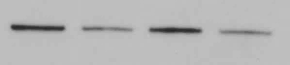

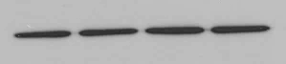
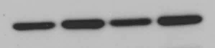

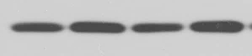
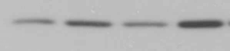

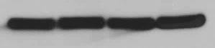
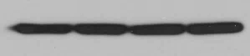
HDAC1/2 are erasers for Kbhb
HEK293
HeLa
si-HDAC1&2
si-HDAC1&2
NS
NS
0.2 μM
Control
1 μM
MS275
5 μM
HDAC1
293T
H3K9bhb
HDAC2
H3K9ac
Tubulin
H3K18bhb
H3K9bhb
H3K18ac
H3K18bhb
H4K8bhb
H4K8bhb
H4K8ac
H3K9ac
H3
H3K18ac
H4K8ac
H3

Slide 14
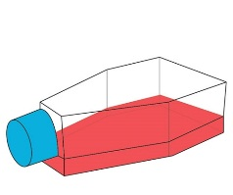
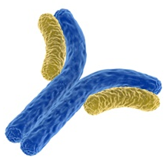
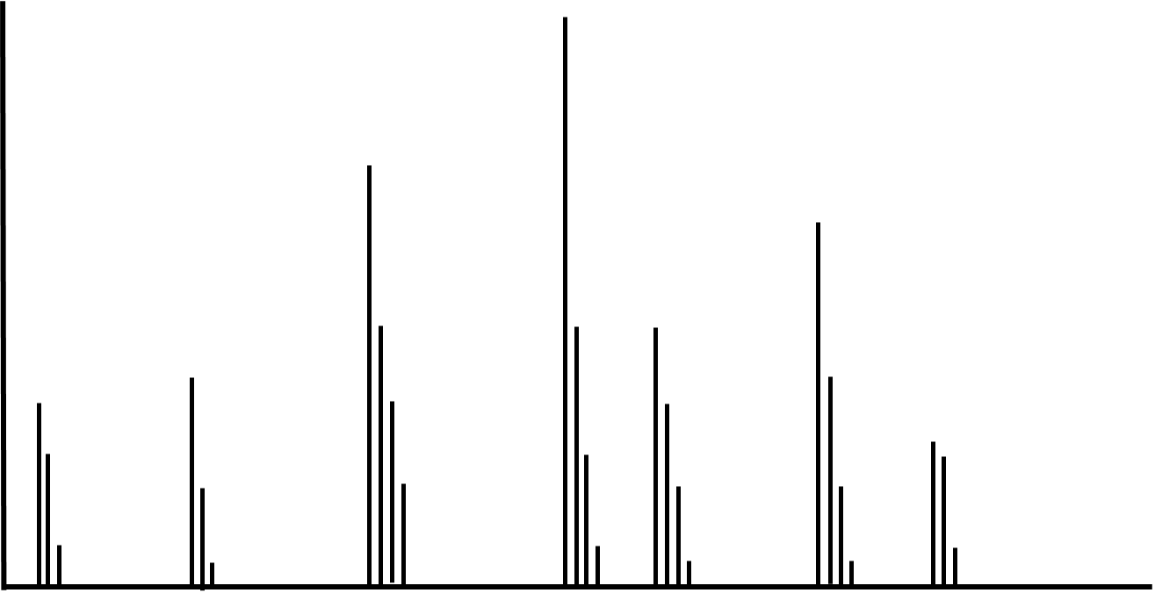

Identification of substrates for Kbhb
HEK293
Cell lysis
Tryptic digestion
Site number
per protein
Identified 3248 Kbhb sites on 1397 proteins
K
b
y
Peptide HPLC fractionation
Affinity enrichment with
anti-K_{bhb} antibody
LC-MS/MS analysis and
database searching

Slide 15
Identification of substrates for Kbhb

Slide 16
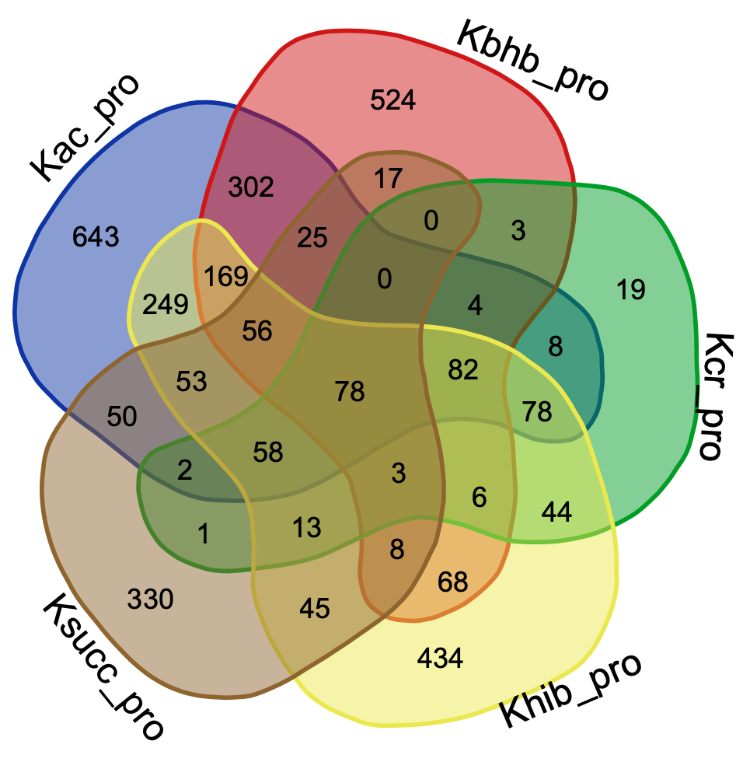

Different distribution of divers PTMs

Slide 17





Different flanking sequences of diverse PTMs
Kbhb
Kac
Khib
Kcr
Ksucc

Slide 18

Different roles of diverse PTMs
Kac: RNA biology
Kcr: Ribosome pathways
Ksucc/Khib: Metabolic pathways
Kbhb: DNA repair, spliceosome

Slide 19

Key Regulatory Elements for Kbhb
p300
CoA
HN
+
NH₂
3248 Kbhb sites
1397 Kbhb proteins
HDAC1/HDAC2
Sci. Adv., 2021, 7, eabe2771

Slide 20



Acknowledgement
SIMM
Dr. Shankang Qi
Cong Yan
Runhua Du
Xuelian Ren
The University of Chicago
Prof. Yingming Zhao
Dr. Di Zhang
Dr. Yejing Weng
Dr. Kyle Delaney
Dr. Chao Peng
The Rockefeller University
Prof. Robert G. Roeder
Dr. Zhanyun Tang
Harvard University
Prof. Philip A. Cole

